Slide 1
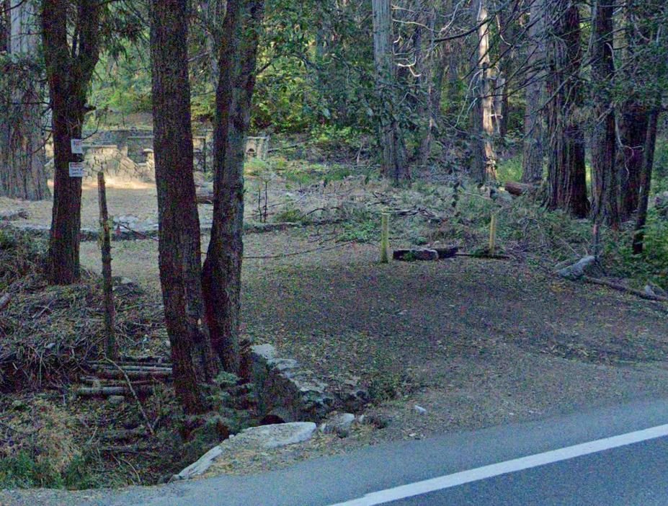
FOR SALE
35.61 AC Blue Jay, CA 92317
Vacant Residential Zoned (RM-14000) Land
Located on CA-189
Lake Arrowhead Area

Slide 2
Exclusively Listed By
Smoke Tree Commercial
DRE #01135909
GREGG COCHRAN, Broker CADRE 01135909
949-667-0322
stcrealestate@mail.com
PROFILE Started in the real estate business as a mortgage broker in 1995. By 2004 had converted the brokerage business to mortgage banking operation and transition into commercial lending. Had successfully closed 600+ mortgage loans covering residential and commercial borrowers.
As part of converting from a brokerage to a banking operation became the chief credit officer, underwriter for conventional, government and commercial loans as a principal owner of the business. During this time period embarked on a secondary mission as a mortgage banking trainer. Authored 15 books for the training operation, which are also included in the Library of Congress achieves.
Other milestones in related fields: Provided expert witness testimony in court cases involving mortgage and real estate fraud. Assisted the US Government, Department of The Treasury, Office of Thrift and Supervision to create the IFR (Independent Foreclosure Review) post the 2008 banking crisis.
Upon the financial crash in 2008, worked to refocus business operations and opportunities in real estate sales. Smoke Tree Commercial Real Estate was established in 2010. Since the creation of STC Real Estate, have closed 200+ transactional sides representing sellers and buyers.
In 2012 joined the Realtors Commercial Alliance of Orange County (the only commercial board of Realtors in California). Commencing in 2015 became a BOD member for this board and in 2018 became the board's Treasurer.
In 2023, joined the Realtors Land Institute as a member.
Education/Licensing includes: CA Real Estate Broker, BSc Real Estate.

Slide 3
Investment Highlights
Blue Jay, CA is a vibrant unincorporated community located in the San Bernardino mountains.
Most of the residents (2314) are full time occupants.
Blue Jay is a CDP (Census Designated Place) which includes Lake Arrowhead.
The area offers a wide range of recreational activities including hiking, mountain biking, fishing, skiing/snow boarding, community events and festivals.
Wide variety hospitality options including Cabins, VRBO, AirBnB, hotels, motels catering to all.
Multiple shops and restaurants from drive-through to sit down adorn the area.
Visitors are a driving force to the area economy as well as vacation and second home owners.
Situated in the San Bernardino National Forest Area.
Closest internal airport is located in Ontario, CA (ONT).

Slide 4
Imagine owning 35.61 acres of untouched forest land in the Lake Arrowhead area of Blue Jay. This land has a rich history as the former site of the Pacific Electric Company's retreat and conference center, and later the Pine View Lodge Resort, a popular destination from 1942 to 1973, and the host of the Lake Arrowhead Music Festival. The resort buildings and 40 cabins are gone, but some of their foundations remain as a testament to the past.
The land is home to a variety of native trees on approximately 27 acres, such as Canyon Live Oak, Ponderosa Pine, Coulter Pine and California Black Oak, forming a beautiful and diverse canopy that reaches up to 38 feet high. The forest is estimated to be 138 years old. The land also has three natural springs, according to local legend.
The land is zoned RM-14,000 and has an elevation range from 5,280 to 5,498 ft. For the most part the land consists of level areas and others which have slight upward slopes of elevation increase up to 218 ft. The land owner directly to the south is the US Government; to the west is a residential HOA and to the north a private owner.
This property offers many possibilities for different uses, such as a) custom home development (one or more units), b) a zoning change to Reservation Conservation [which may qualify for tax credits], c) event use center, such as wedding venues, d) use as a group home, religious retreat, etc. Other uses could be an acquisition to meet Carbon Credits needs.
This is a rare opportunity to own a piece of history and nature in a convenient location!

Slide 5
Potential Land Use Opportunities:
AG/Timber,
Resource & Open Space uses,
Meeting Facility (public or private),
Park,
Playground,
Place of Worship (Religious Use),
Residential Development,
Dependent Housing,
Group Residential,
Guest House,
MHP,
Multiple Dwelling Units 50+,
Child Care,
Licensed Residential Care,
Lodging (BnB),
Short-term home rentals (community of short-term rentals),
Temp Special Events (Wedding Venue, etc.).

Slide 6
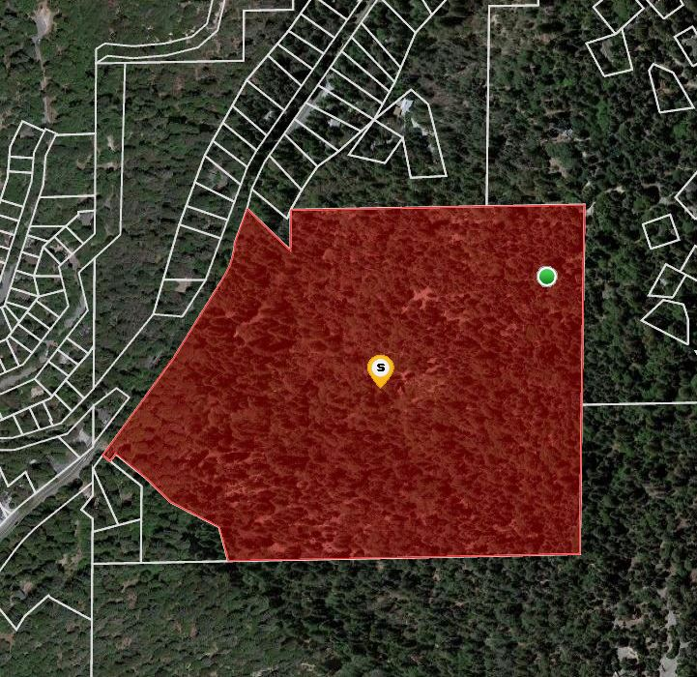
Address: 26963 State Hwy 189, Blue Jay, CA
APN: 0335-011-29
Ownership: Fee Simple
Lot Size: ±35.61 AC
Zoning: RM-14000
Asking: $1,798,000
Last Valuation: 11-18-2021 ($1,790,000)
[MAI Appraisal]

Slide 7
COMPARABLE SALES
 | Site | City | Price | AC | Date | Status | Zoning
#4 | Amargosa Rd | VTVL | $ 1,995,000. | 43.08 AC | 4/17/2023 | Sold | C2-T
#5 | Seneca Rd | VTVL | $ 1,500,000. | 31.26 AC | 8/3/2023 | Sold | R-3T
#3 | Main St | BSTW | $ 1,200,000. | 45.53 AC | 11/20/2023 | Sold | C
#2 | Rim of the World Hwy | RSA | $ 1,935,000. | 58.52 AC | 8/1/2023 | Sold | HT/RC
#1 | 11700 Aspen Rd | OKH | $ 3,600,000. | 75.75 AC |  | Pending

Slide 8
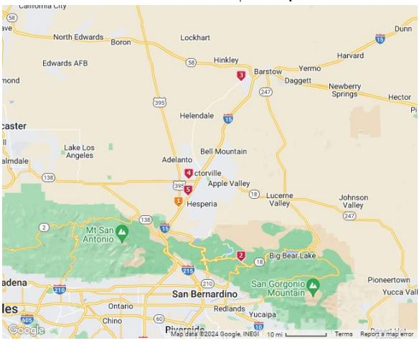
Mapped Copmarable Sales

Slide 9
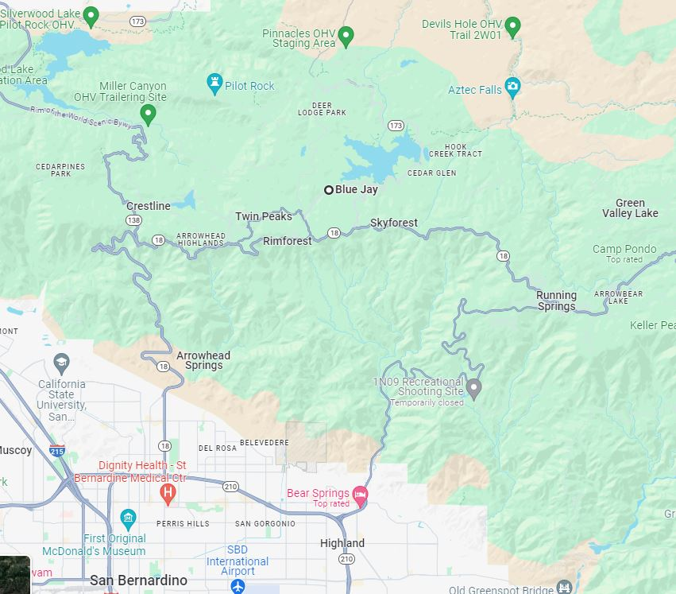
Local Area Map

Slide 10
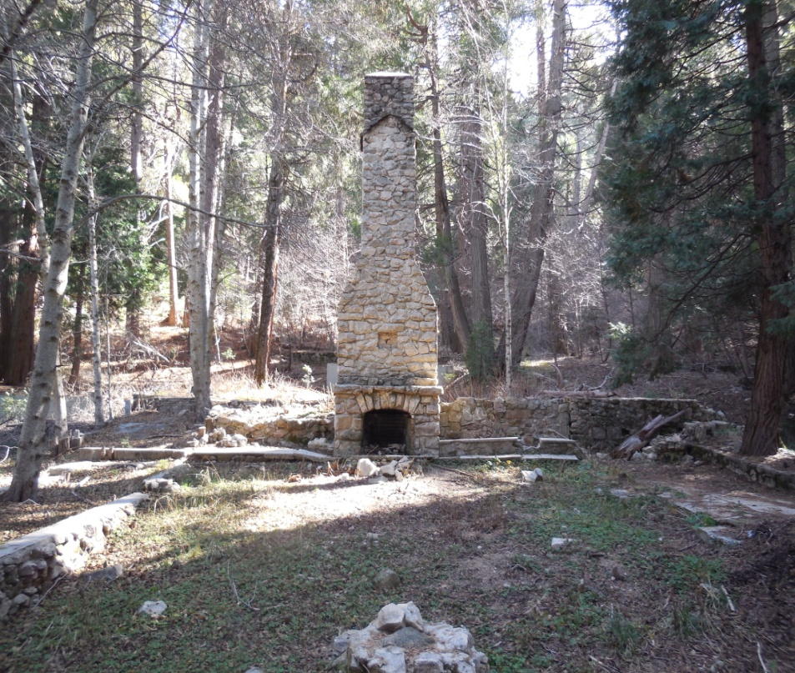
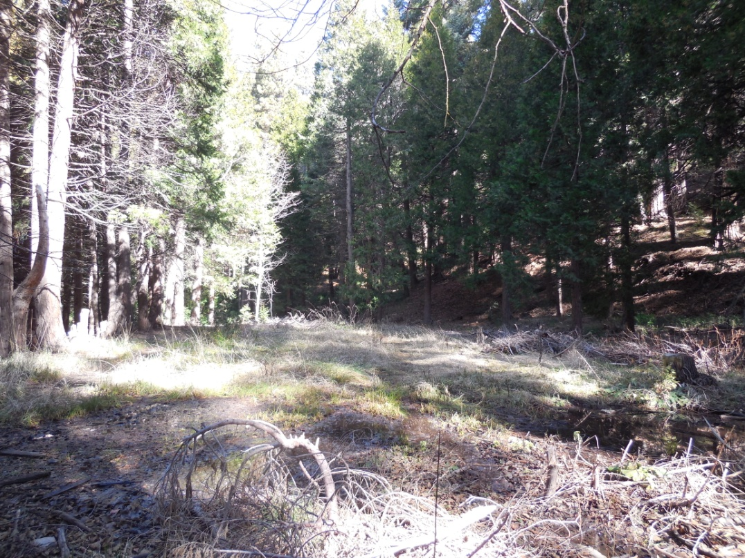
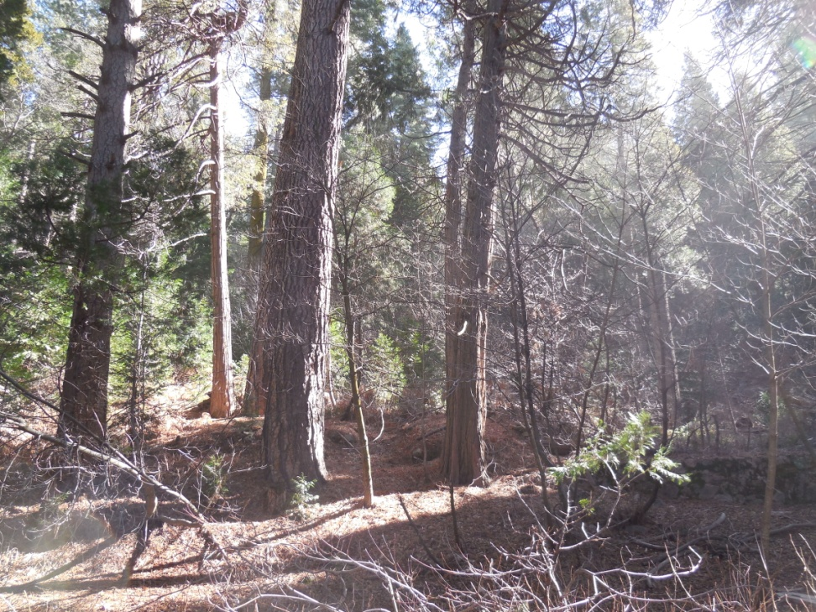
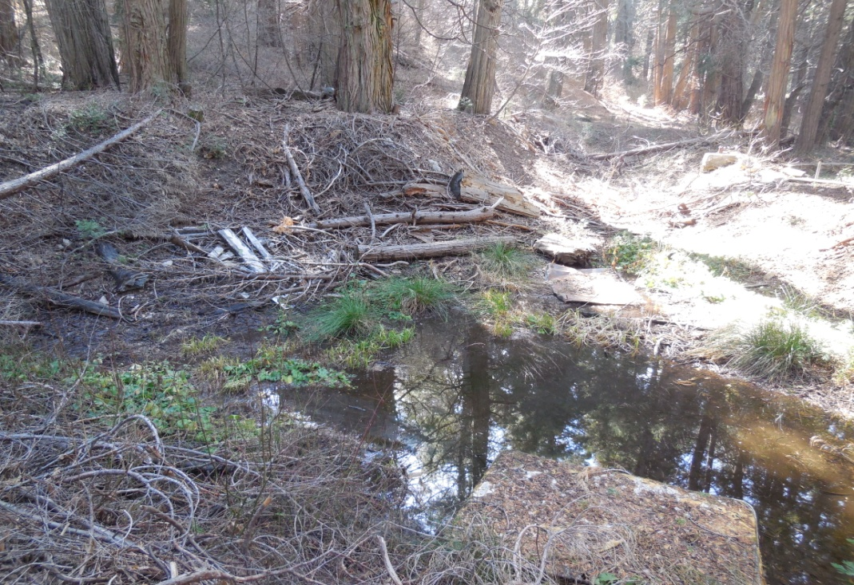
Remains of Grand Lodge
View to the Southwest
Natural Spring

Slide 11
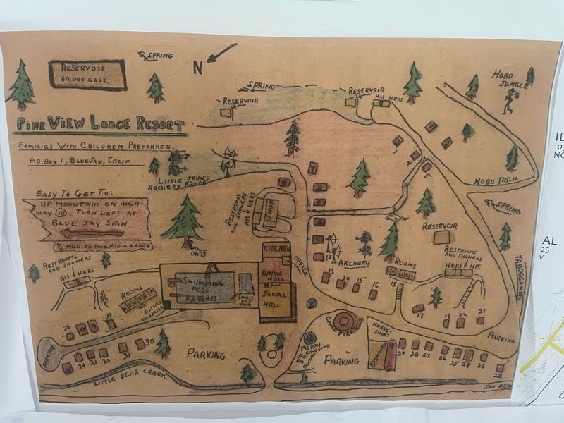
Historic Diagram of Former Resort

Slide 12
Contact for Offers
Gregg Cochran, Broker #01135909
Smoke Tree Commercial
949-667-0322
stcrealestate@mail.com

